Slide 1
Google Data Analytics Capstone Project: Cyclistic bike-share analysis
Tableau Dashboard
Github

Slide 2
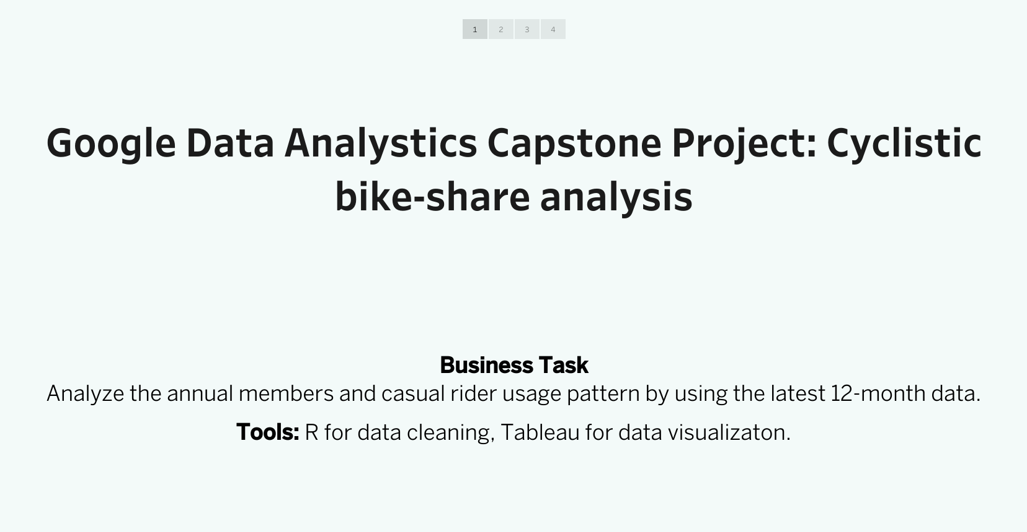

Slide 3
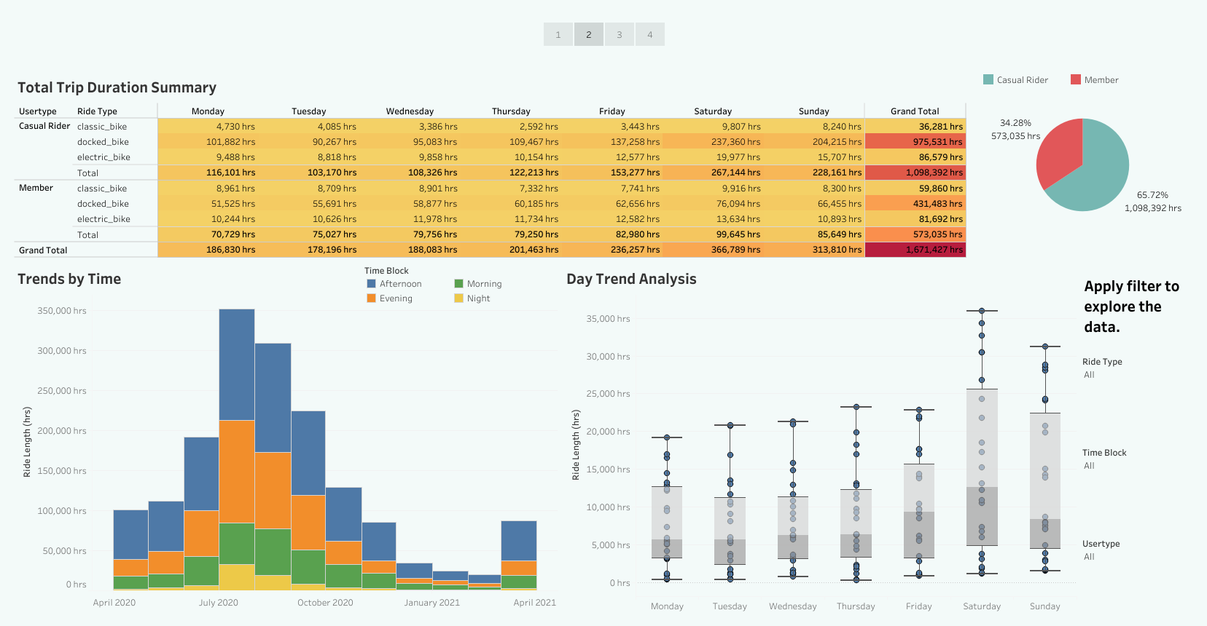

Slide 4
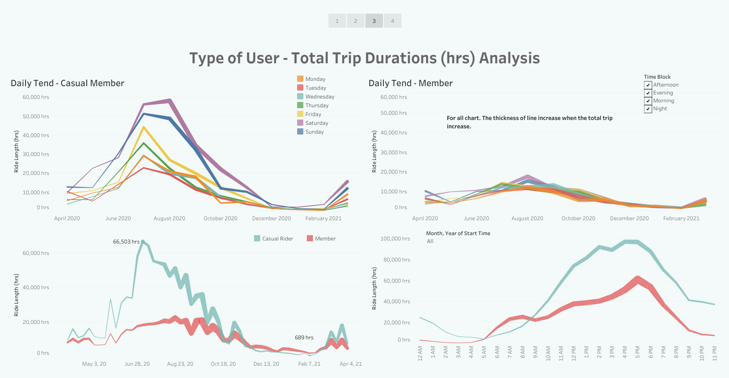

Slide 5
